Slide 1


JAVA INTERVIEW BOOTCAMP ADVANCE CONCEPTS
Lecture 16
Advance Concepts In OOP

Slide 2
CHAPTER 17
OOPs & Advanced OOPs
Topics Covered
OOP Concepts
Encapsulation
Inheritance & Advance Concepts
Polymorphism & Advance Concepts

Slide 3
What is OOP?
A programming paradigm which is based on real world model of objects or entities.
It is organized around objects rather than "actions" and data rather than “logic”.

Slide 4
What is OOP?
Object-oriented programming takes the view that what we really care about are the objects we want to manipulate rather than the logic required to manipulate them.

Slide 5
Important Terminologies Of OOPs
Object
Class
Abstraction
Encapsulation
Polymorphism
Inheritance
Composition

Slide 6
Object
Any real world entity which is composed of some characteristics and behavior .
The characteristics are related to the “Data” and behavior to the “Operation”.

Slide 7
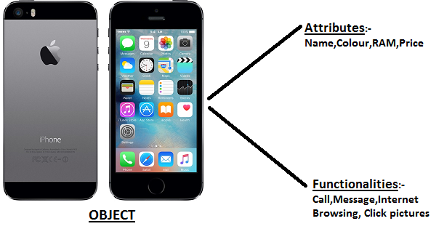
Example

Slide 8
Class
In Object Oriented Programming, a Class is a blueprint for an object.
In fact, classes describe the type of objects, while objects are usable instances of classes.
Each Object is built from the same set of blueprints and therefore contains the same components (properties and methods).

Slide 9



Example
Mobile Phones
Class
Objects
Samsung
Nokia
iPhone

Slide 10
Syntax Of Creating A Class In Java
[access modifier] | [non-access modifiers] class <classname>
{
[access modifier] | [non-access modifiers] <data type> <var_name>=[value];
.
.
[access modifier] | [non-access modifiers] <return type> <method>(<arg>)
{
// method body
}
.
.
}

Slide 11
Example Of Creating A Class In Java
class Student
{
private int roll;
private String name;
private double per;
public void setData(int r,String s,double p)
{
roll=r;
name=s;
per=p;
}

Slide 12
Example Of Creating A Class In Java
public void showData()
{
System.out.println(“Roll= “+roll);
System.out.println(“Name=“+name);
System.out.println(“Per=“+per);
}
}

Slide 13
Syntax Of Instantiating A Class
To create objects of a class we follow a two step
procedure in Java:
Declaring object reference
<classname> <object_ref>;
Creating object and assigning it to object reference
<object_ref>=new <classname>( );

Slide 14
Example Of Instantiating A Class
Student s;
s=new Student();
OR
Student s=new Student();

Slide 15
Popular Interview Question
Qn. In how many ways can you create object of a class ?
Ans: In 5 ways:
Using new keyword
Using newInstance() method of class Class
Using Constructor class
Using clone() method of Object class
Using Deserialization

Slide 16
Popular Interview Question
Qn. What’s the difference in these ways ?
Ans: In first 3 approaches the constructor of the class getting instantiated will be called , while in the last 2 ways no constructor calling will take place.

Slide 17
Creating Object Using newInstance()
The newInstance() method belongs to the class Class
and has the following prototype:
public Object newInstance() throws InstantiationException,
IllegalAccessException
Sample Code:
Class c=Class.forName("Person");
Person p=(Person)c.newInstance();

Slide 18
Creating Object Using newInstance()
Another Way:
Sample Code:
Class c=Person.class;
Person p=(Person)c.newInstance();

Slide 19
Creating Object Using Constructor class
There is another newInstance() method which belongs to
the class java.lang.reflect.Constructor and has the following
prototype:
public Object newInstance(Object … values) throws InstantiationException,
IllegalAccessException,IllegalArgumentException,
InvocationTargetException
Sample Code:
Constructor c=Person.class.getConstructor();
Person p=(Person)c.newInstance();

Slide 20
The Difference In Both newInstance()
The newInstance() method of Class class can invoke only no-arg
constructor of the class .
When a class has parameterized constructors we cannot use
newInstance() method of Class class
In it’s place we need to go for the newInstance() method
of the Constructor class:
Sample Code:
Constructor c;
c=Person.class.getConstructor(int.class,String.class);
Person p=(Person)c.newInstance(25,”Amit”);

Slide 21
What Benefit We Get With newInstance() Compared With new ?
Allows us to create objects at runtime
It is the way many frameworks like Spring and Hibernate create objects for us.
Helps us implement Factory Design Pattern in a more clean way

